Slide 1
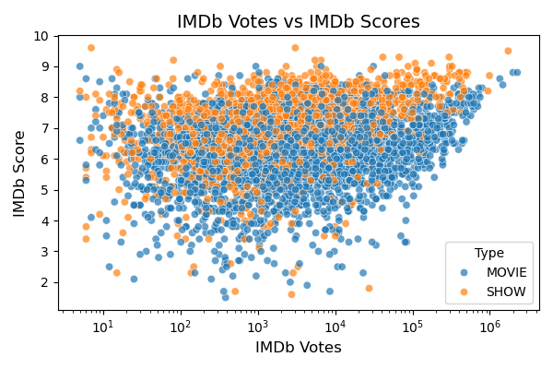
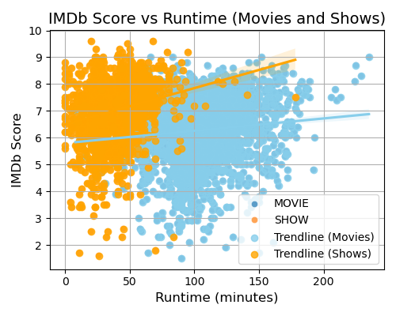
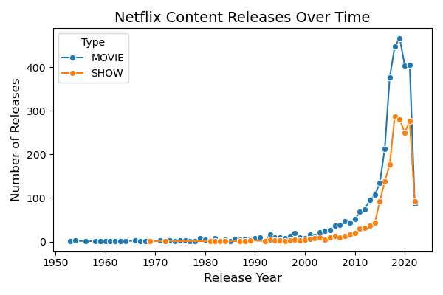
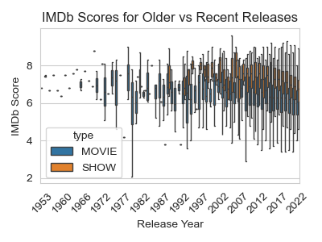
Netflix Analytics: How Trends and Ratings Drive Viewer Engagement
Group 23: Daniel Schipfer • Monika Windhager • Kaniz Fatema • Abdelrahman Ali
TU Graz University - Austria
Research Questions
Correlation: 0.19. & p-value: 5.56e-44
Movies: Correlation: 0.11, p-value: 0.0000
Shows: Correlation: 0.22, p-value:0.0000
T-statistic: 7.40
P-value: 2.05e-13
How Netflix's Content Evolved Over Time ?
Do movies and shows with higher votes likely to have better scores?
What is the Correlation between runtime and scores?
Are older movies/shows more likely to have higher scores than recent releases?
Data and Methods
The dataset used contains information about Netflix’s content as “Titles”, “Types”, “Release Year”, “Runtime”, “Votes”, and “Scores”.
Methods Used include:
1. Trend Analysis with Line Plot.
2. Correlation Analysis with Scatter Plot.
3. Statistical T-Test with Box Plot.
4. fdfdf
Results
There is a huge decrease in Netflix’s content last years for both “Movies” and “Shows”. Also, the distribution is highly skewed.
 | count | mean | std | min | 25% | 50% | 75% | max
MOVIE | 66 | 51.38 | 112.88 | 1.00 | 1.25 | 7.00 | 33.50 | 466.00
SHOW | 40 | 46.90 | 85.44 | 1.00 | 1.75 | 6.50 | 32.50 | 286.00

